Slide 1
Conference Attendees’ Satisfaction with Convention Facility Services: An Integrated Model of Individual & Shared Experiential Value
HeeKyung Sung, PhD Candidate Woojin Lee, Associate Professor School of Community Resources and Development
Arizona State University Joanne Jung-Eun Yoo, Associate Professor Department of Hotel, Restaurant & Institutional Management
University of Delaware

Slide 2
Introduction
The industry has viewed attendee-centered service to be a key ingredient in creating high-quality experience, while today’s consumption is now changing from commodities, goods, and services to experiences (Schmitt, 1999).
Customer experiences influence the perception of service quality and satisfaction. However, relatively few studies have examined how attendees perceive their experience while attending an event at a convention center and the relationship between the perceived service quality and attendees’ experiential consumption values.
This study aims to understand the role of individual experiential values and the relationship between different level of service quality, experiential value, and satisfaction of the entire convention facility.

Slide 3
Theoretical Background
Convention Industry (CIC, 2014)
1.87 million meeting events
$280 billion in spending
1.78 million jobs
$67 billion in labor revenue
Lee and Park (2002) defined ‘Convention Service’ as
The sum of all services from attendees’ arrival to departure
Convention-related activities
The combination of tangible and intangible services

Slide 4
Theoretical Background
Applying Matzler and Sauerwein’s (2002) three-factor structure of customer service quality, this study divided service attributes into basic, performance, and excitement factors.
Basic factors are defined as minimum requirements that cause dissatisfaction if not fulfilled, but do not lead to customer satisfaction if fulfilled or exceeded (Fuchs & Weiermair, 2004; Matzler & Sauerwein, 2002) including overall cleanliness, restroom accessibility, meeting facility maintenance, and etc.
Performance factors are directly linked to customers’ needs and desires resulting in customers’ satisfaction if fulfilled, or leading to dissatisfaction if unfulfilled (Deng, Kuo, & Chen, 2008), including Local food facilities, in-house food, F & B outlets availability, and Wi-Fi availability.
Excitement factors are generally provided to customers beyond their needs and expectation; since these factors are unexpected and surprise customers, high performance on these factors influences far more on the overall customer satisfaction than low performance does (e.g., unique architecture design, night entertainment availability, green efforts, and etc).

Slide 5
Theoretical Background
According to ‘experiential marketing’ by Schmitt (1999), experiences are caused by direct observation and/or participation in events; Customers receive each type of experiential stimulation (e.g., individual and shared experiences) via the process of experiencing services or products.
Individual experiences | Shared experiences
Sense: sensory qualities such as sight, sound, taste etc. Feel: affective side such as moods and emotions | Act: physical and behavioral experiences which could enrich their life style. Relate: social experiences such as connection with people

Slide 6
Theoretical Background
Delivering high-quality service leads to customer satisfaction; furthermore, the experiential value is critical to induce customer satisfaction and loyalty.
Tourists’ experiential marketing (consumption value) and their satisfaction have a positive relationship (Wang & Lin, 2010)
Customers’ perceived service quality, driven from their experiential consumption of the product or service influences customer satisfaction and loyalty (Lee, Hsiao, & Yang, 2010)

Slide 7
Methodology
Data Collection
When: International City/County Management Association's (ICMA) meetinng, 2012 Oct.
Where: Phoenix Convention Center (PCC)
Self-administered questionnaire
23 items of convention service factors
10 items for experiential values
3 items for satisfaction
54% of response rate (217 out of 400)
Analysis
Confirmatory factor analysis (CFA)
Structural equation modeling (SEM)

Slide 8
Findings
Basic Service
Individual Experiential Value
.73***
Attendees’
Satisfaction
Performance Service
.41*
Shared Experiential Value
.21***
Excitement Service
.34**
Figure1. Results of SEM (*** p<.001, ** p<.01, * p<.05)
X²/df = 1.8, GFI =.9, CFI =.91, IFI =.91, RMSEA = .06

Slide 9
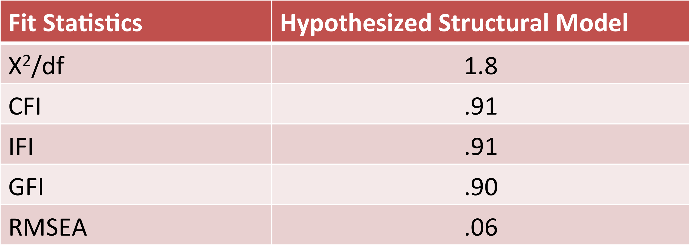
Findings
Confirmatory Factor Analysis
Factor analysis facilitated grouping of the 23 items that described different kinds of services provided by the Phoenix Convention Center into three reduced dimensions: basic, performance, and excitement factor.
Fit Indices For the Hypothesized Structural Model

Slide 10
Findings
Structural Equation Modeling
Amos 22.0 software (Arbuckle, 2007) was utilized to perform the SEM with all the casual relationships being tested simultaneously.
The current study included six total constructs including three convention factors, individual experiential value, shared experiential value and customer satisfaction.
Based on the value of all the correlation estimates between the associated constructs, all values fell in the acceptable range (p<.85, p>.10) which indicated that the discriminant validity of the constructs was supported.

Slide 11
Findings
The excitement service quality factors have an influence on both individual and shared experiential consumption values which can have an effect on the overall satisfaction of the PCC.
More specifically, only perceived quality of the excitement services have a significant influence on individual experiential value (β=.41, p<.01) and shared experiential value (β=.34, p<.05).
The evoked individual and shared experience value have a significant effect on the overall satisfaction of the convention center (β=.73, p<.001, β=.21, p<.001).
In sum, customers’ perceived service quality induces customers’ overall satisfaction through experiential consumption value (individual and shared experiential value).

Slide 12
Discussions and Implications
This study can serve as the basis for future research on experiential marketing and customer satisfaction with convention product or service.
This study provides important insights with respect to enhancing their competitiveness.
Identify distinctive services and venue facilities
Provide service excellence
Create the different level of customers’ memorable experiences
The current study provides managers with valuable insights to implement experiential marketing strategies to market their convention facility.
It helps convention centers develop effective promotional strategies and gain a competitive advantage over other convention centers

